Slide 1
COMP 3322
SWE
Fall 2026
Mohammed Ayyat, Ph. D.
Prairie View A&M University
Department of Computer Science

Slide 2
Learning Objectives
5.1 Context models
5.2 Interaction models
5.3 Structural models
5.4 Behavioral models

Slide 3
System Modeling
Process of developing abstract models of a system, with each model presenting a different view or perspective of that system.
Representing a system using graphical notation – such as Unified Modeling Language (U M L).
Analyst to understand the functionality of the system and models used to communicate with customers.

Slide 4
Existing and Planned System Models
Models of the existing system -- help clarify what the existing system does and can be used as a basis for discussing its strengths and weaknesses.
Models of the new system -- help explain the proposed requirements to other system stakeholders -- engineers use these models to discuss design proposals and to document the system for implementation.
In a model-driven engineering process, it is possible to generate a complete or partial system implementation from the system model.

Slide 5
System Perspectives
An external perspective -- model the context or environment of the system.
An interaction perspective -- model the interactions between a system and its environment, or between the components of a system.
A structural perspective -- model the organization of a system or the structure of the data that is processed by the system.
A behavioral perspective -- model the dynamic behavior of the system and how it responds to events.
Notes:
You may develop different models to represent the system from different
perspectives.

Slide 6
U M L Diagram Types
Activity diagrams -- activities involved in a process or in data processing.
Use case diagrams -- interactions between a system and its environment.
Sequence diagrams -- interactions between actors and the system and between system components.
Class diagrams -- object classes in the system and the associations between these classes.
State diagrams -- how the system reacts to internal and external events.
Notes:
UML became a standard language for object-oriented modeling.
The UML has 13 diagram types and so supports the creation of many
Different types of system model. However, a survey showed that most users of the UML thought that five diagram types could represent
the essentials of a system.

Slide 7
Context Models
Context models illustrate a system's operational context - they show what lies outside the system boundaries.
Social and organizational concerns may affect the decision on where to position system boundaries.
Architectural models show the system and its relationship with other systems.

Slide 8
System Boundaries
Define what is inside and what is outside the system.
  They show other systems that are used or depend on the system being developed.
Has a profound effect on the system requirements.
Political judgment
  There may be pressures to develop system boundaries that increase/decrease the influence or workload of different parts of an organization.

Slide 9
The Context of the Mentcare System
Notes:
External systems might produce data for or consume data from the system. They might share data with
the system or be connected directly through a network or not connected
at all. They might be physically co-located or located in separate buildings

Slide 10
Process Perspective
Process models reveal how the system being developed is used in broader business processes.
UML activity diagrams may be used to define business process models.

Slide 11
Process Model of Involuntary Detention

Slide 12
Interaction Models
Modeling user interaction is important as it helps to identify user requirements.
Modeling system-to-system interaction highlights the communication problems that may arise.
Modeling component interaction helps us understand if a proposed system structure is likely to deliver the required system performance and dependability.
Use case diagrams and sequence diagrams may be used for interaction modeling.

Slide 13
Use Case Modeling
Use cases were developed originally to support requirements elicitation and now incorporated into the U M L.
Each use case represents a discrete task that involves external interaction with a system.
Actors in a use case may be people or other systems.
Represented diagrammatically to provide an overview of the use case and in a more detailed textual form.

Slide 14
Transfer-data use case
A use case in the Mentcare system

Slide 15
Tabular Description of the ‘Transfer Data’ Use-Case
MHC-PMS: Transfer data
Actors | Medical receptionist, patient records system (PRS)
Description | A receptionist may transfer data from the Mentcare system to a general patient record database that is maintained by a health authority. The information transferred may either be updated personal information (address, phone number, etc.) or a summary of the patient’s diagnosis and treatment.
Data | Patient’s personal information, treatment summary
Stimulus | User command issued by medical receptionist
Response | Confirmation that PRS has been updated
Comments | The receptionist must have appropriate security permissions to access the patient information and the PRS.

Slide 16
Use Cases in the Mentcare System Involving the Role ‘Medical Receptionist’

Slide 17
Sequence Diagrams
Sequence diagrams are part of the U M L and are used to model the interactions between the actors and the objects within a system.
A sequence diagram shows the sequence of interactions that take place during a particular use case or use case instance.
The objects and actors involved are listed along the top of the diagram, with a dotted line drawn vertically from these.
Interactions between objects are indicated by annotated arrows.

Slide 18
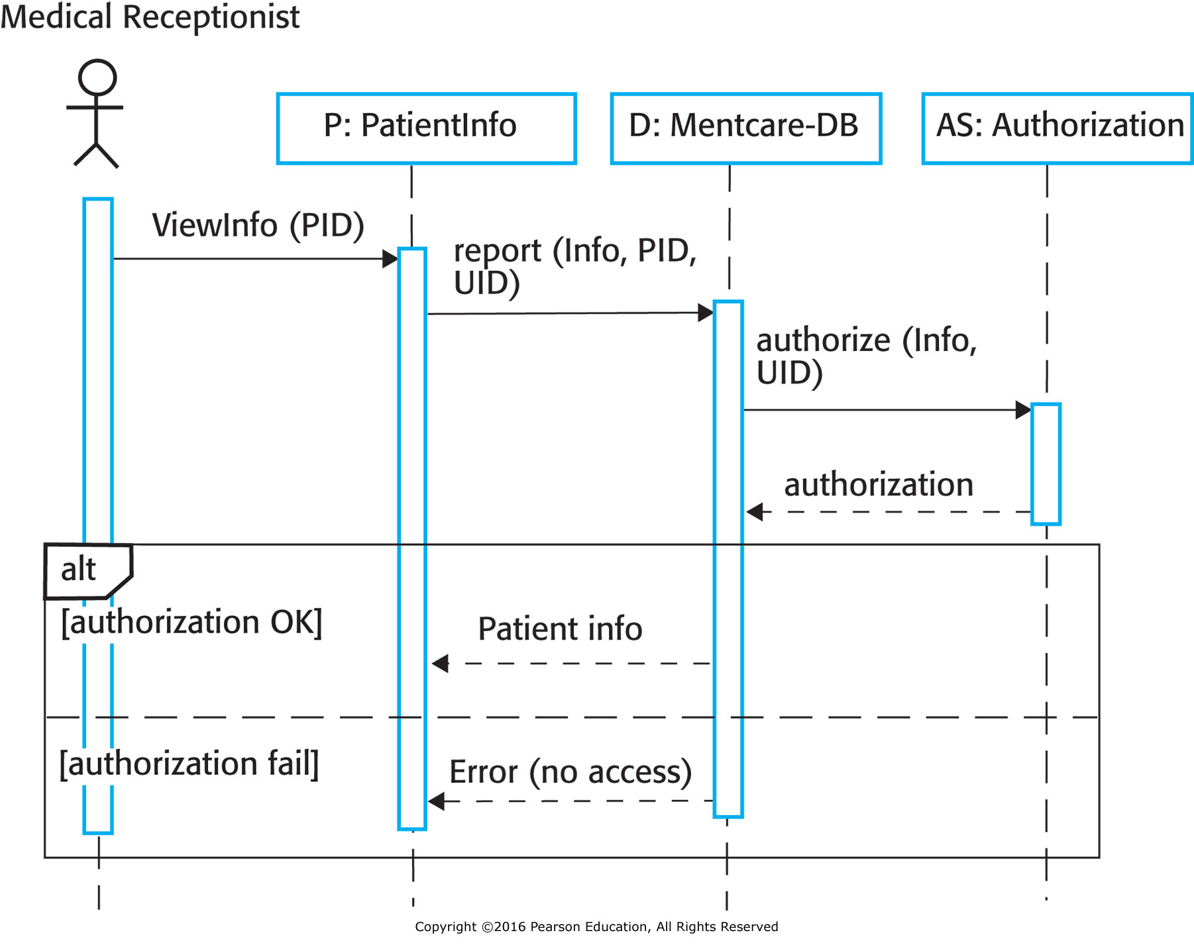
Sequence Diagram for View Patient Information
Notes:
Object name, dashed line
Thin Rectangle – activation of operation
Line and arrowhead -- Message , return message

Slide 19
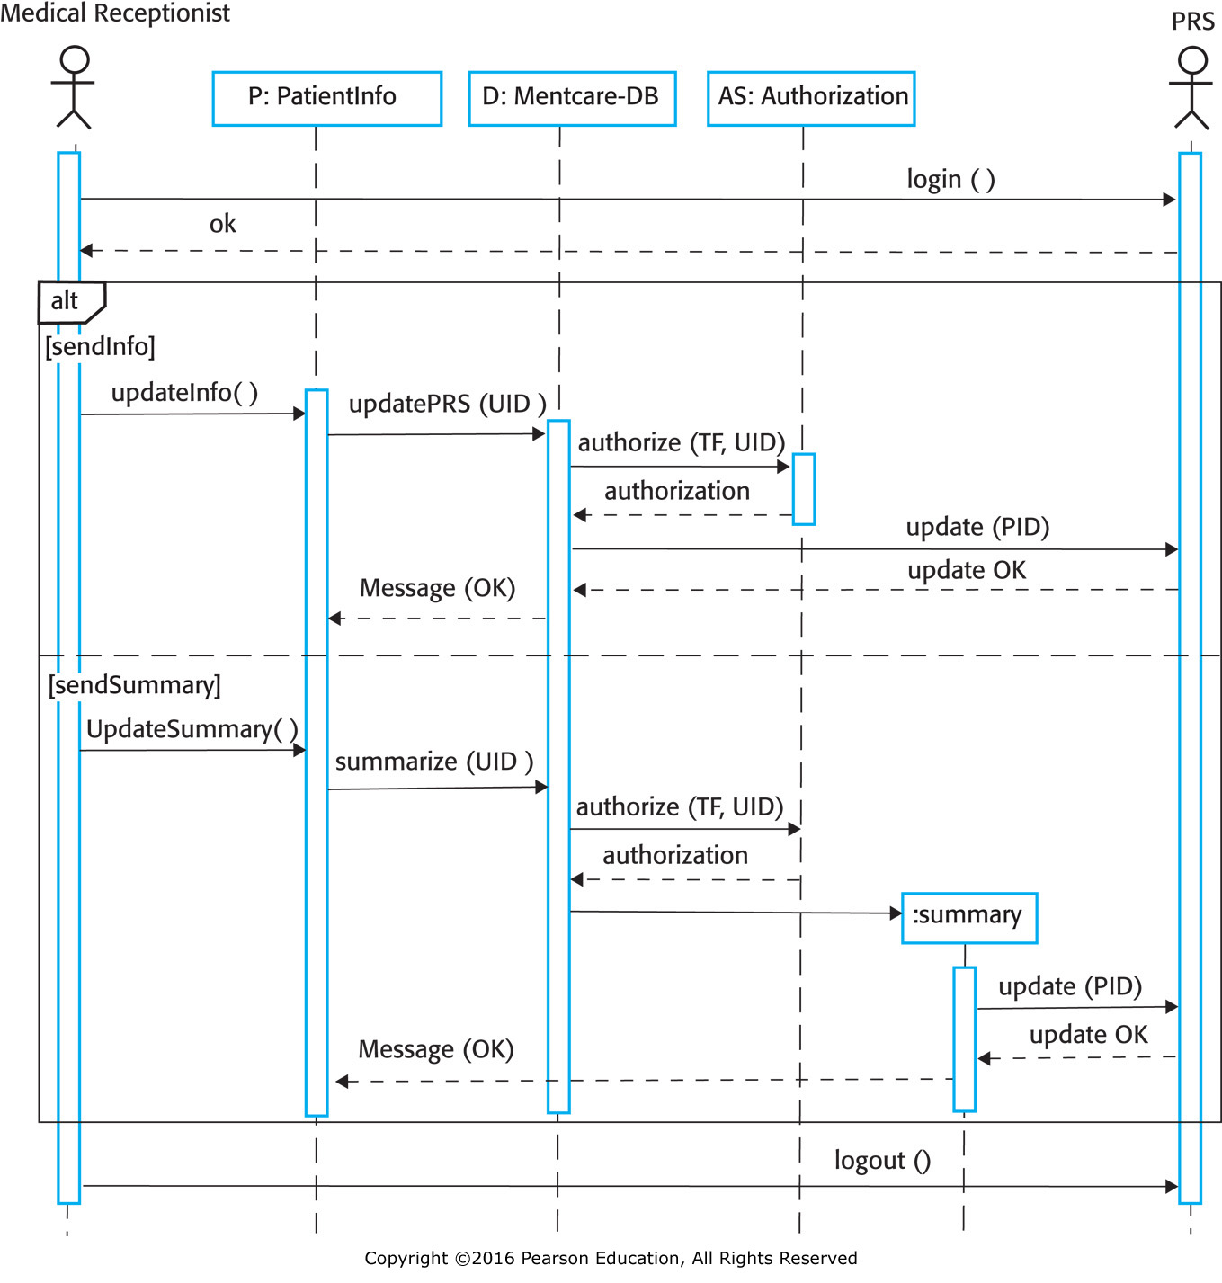
Sequence Diagram for Transfer Data

Slide 20
Structural Models
Structural models of software display the organization of a system in terms of the components that make up that system and their relationships.
Structural models may be static models, which show the structure of the system design, or dynamic models, which show the organization of the system when it is executing.
You create structural models of a system when you are discussing and designing the system architecture.

Slide 21
Class Diagrams
Class diagrams are used when developing an object-oriented system model to show the classes in a system and the associations between these classes.
An object class can be thought of as a general definition of one kind of system object.
An association is a link between classes that indicates some relationship between these classes.
When you are developing models during the early stages of the software engineering process, objects represent something in the real world, such as a patient, a prescription, a doctor, etc.

Slide 22
U M L Classes and Association

Slide 23
Classes and Associations in the M H C-P M S

Slide 24
The Consultation Class

Slide 25
Generalization (1 of 2)
Generalization is an everyday technique that we use to manage complexity.
Rather than learn the detailed characteristics of every entity that we experience, we place these entities in more general classes (animals, cars, houses, etc.) and learn the characteristics of these classes.
This allows us to infer that different members of these classes have some common characteristics e.g. squirrels and rats are rodents.

Slide 26
Generalization (2 of 2)
Examine the classes if there is scope for generalization. If changes are proposed, then you do not have to look at all classes in the system to see if they are affected by the change.
Like Java, generalization is implemented using the class inheritance mechanisms built into the language.
The attributes and operations associated with higher-level classes are also associated with the lower-level classes.
The lower-level classes are subclasses that inherit the attributes and operations from their superclasses. Lower-level classes add more specific attributes and operations.

Slide 27
A Generalization Hierarchy

Slide 28
A Generalization Hierarchy with Added Detail

Slide 29
Object Class Aggregation Models
An aggregation model shows how classes that are collections are composed of other classes.
Aggregation models are similar to the part-of relationship in semantic data models.

Slide 30
The Aggregation Association
Notes:
patient record is an aggregate of Patient and an indefinite number of Consultations. That is, the record maintains personal patient information as well as an individual record for each consultation with a doctor.
Patient record has a patient and consultation (many). Even if patient record class is removed, patient and consultation can exist independently

Slide 31
Behavioral Models
Behavioral models are models of the dynamic behavior of a system as it is executing. They show what happens or what is supposed to happen when a system responds to a stimulus from its environment.
Two types of stimuli:
  Data: Some data arrives that has to be processed by the system.
  Events: Some event happens that triggers system processing.

Slide 32
Data-Driven Modeling
Many business systems are data-processing systems that are primarily driven by data. They are controlled by the data input to the system, with relatively little external event processing.
Data-driven models show the sequence of actions involved in processing input data and generating an associated output.
They are particularly useful during the analysis of requirements as they can be used to show end-to-end processing in a system.

Slide 33
An Activity Model of the Insulin Pump's Operation
Processing steps - activities (rounded rectangles)
Data flowing between steps - objects (rectangles)
Notes:
shows the chain of processing involved in the insulin pump software. You can see the
processing steps, represented as activities (rounded rectangles), and the data flowing between these steps, represented as objects (rectangles).

Slide 34
Sequence of processing – Sequence diagram (example: Order Processing)
Notes:
Sequence models highlight objects in a system, whereas data-flow diagrams highlight the operations or activities. In practice, nonexperts seem to find data-flow diagrams more intuitive, but engineers prefer sequence diagrams.

Slide 35
Event-Driven Modeling
Real-time systems are often event-driven, with minimal data processing. For example, a landline phone switching system responds to events such as ‘receiver off hook’ by generating a dial tone.
Event-driven modeling shows how a system responds to external and internal events.
It is based on the assumption that a system has a finite number of states and that events (stimuli) may cause a transition from one state to another.

Slide 36
State Machine Models
These model the behavior of the system in response to external and internal events.
They show the system’s responses to stimuli. Used for modeling real-time systems.
Show system states as nodes and events as arcs between these nodes. When an event occurs, the system moves from one state to another.
Statecharts are an integral part of the UML and used to represent state machine models.

Slide 37
State Diagram of a Microwave Oven

Slide 38
Microwave Oven Operation

